Slide 1
COURSE NAME – Cloud and devops COURSE CODE:22CS2243F
Cohort-E27 (SEDP)
Software engineering mis and Devops
prepared by :nirosha bandla
Topic:
DOCKER IMAGE AND COMPOSE

Slide 2
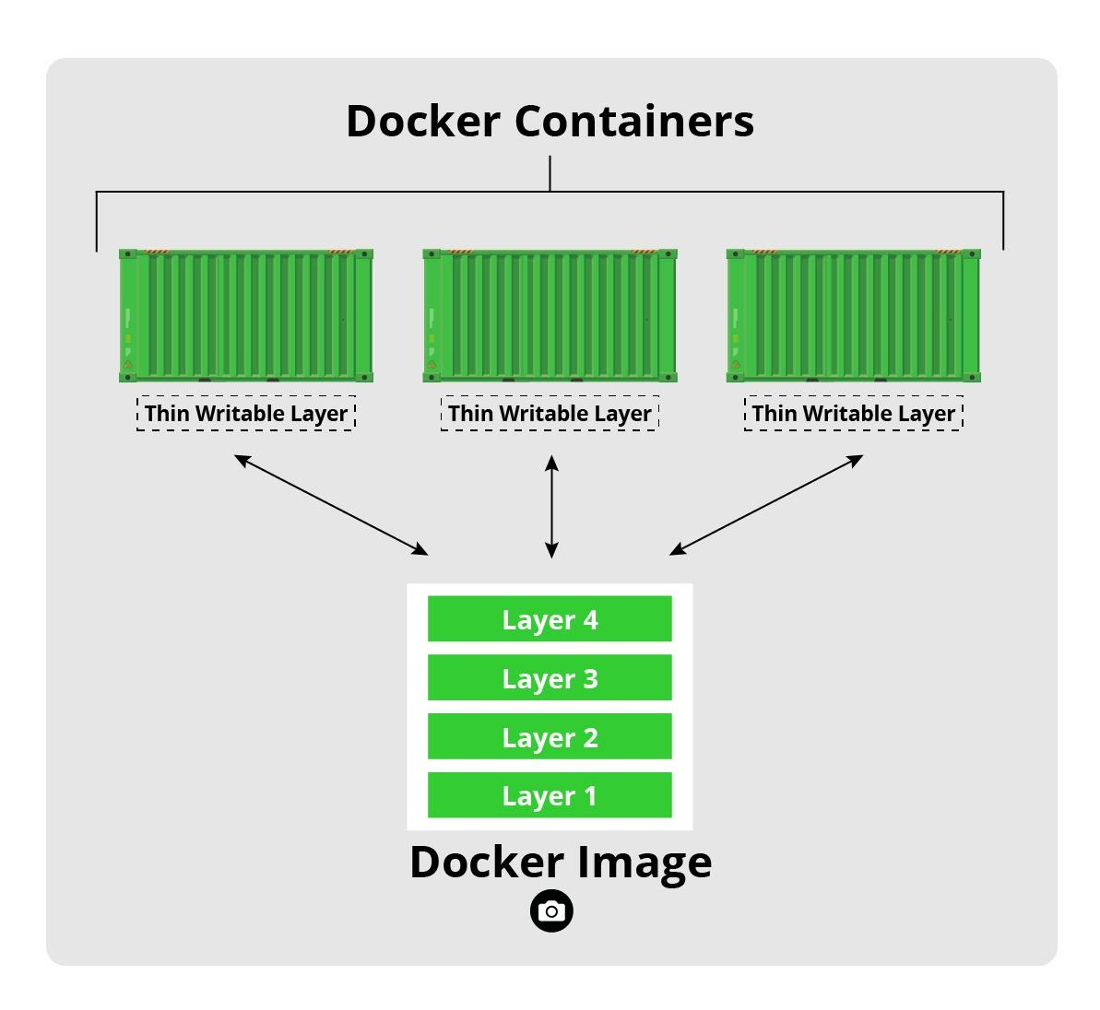
Dockers image definition
A Docker image is a file used to execute code in a Docker container.
Docker images act as a set of instructions to build a Docker container, like a template.
Docker images also act as the starting point when using Docker. An image is comparable to a snapshot in virtual machine (VM) environments.

Slide 3
Images stored in??
Docker images are stored in two files as shown by following command. /var/lib/docker/aufs/diff/<id> has the file contents of the images. /var/lib/docker/repositories-aufs is a JSON file containing local image information. This can be viewed with the command docker images.

Slide 4
Images can exist without containers, whereas a container needs to run an image to exist. T
herefore, containers are dependent on images and use them to construct a run-time environment and run an application.
The two concepts exist as essential components (or rather phases) in the process of running a Docker container. Having a running container is the final “phase” of that process, indicating it is dependent on previous steps and components.
That is why docker images essentially govern and shape containers.

Slide 5
Anatomy of a Docker Image
A Docker image is made up of a collection of files that bundle together all the essentials – such as installations, application code, and dependencies – required to configure a fully operational container environment. You can create a Docker image by using one of two methods:
Interactive: By running a container from an existing Docker image, manually changing that container environment through a series of live steps, and saving the resulting state as a new image.
Dockerfile: By constructing a plain-text file, known as a Dockerfile, which provides the specifications for creating a Docker

Slide 6
Docker Layers
Each of the files that make up a Docker image is known as a layer.
These layers form a series of intermediate images, built one on top of the other in stages, where each layer is dependent on the layer immediately below it.
The hierarchy of your layers is key to efficient lifecycle management of your Docker images. Thus, you should organize layers that change most often as high up the stack as possible. This is because, when you make changes to a layer in your image, Docker not only rebuilds that particular layer, but all layers built from it.
Therefore, a change to a layer at the top of a stack involves the least amount of computational work to rebuild the entire image.

Slide 7
Parent Image
In most cases, the first layer of a Docker image is known as the “parent image”. It’s the foundation upon which all other layers are built and provides the basic building blocks for your container environments. You can find a wide variety of ready-made images for use as your parent image on the public container registry, Docker Hub.
You can also find them on a small number of third-party services, such as the Google Container Registry. Alternatively, you can use one of your own existing images as the basis for creating new ones.

Slide 8
Base Image
A typical parent image may be a stripped-down Linux distribution or come with a preinstalled service, such as a database management system (DBMS) or a content management system (CMS)
In simple terms, a base image is an empty first layer, which allows you to build your Docker images from scratch. Base images give you full control over the contents of images, but are generally intended for more advanced Docker users.

Slide 9
Container Registries
Container registries are catalogs of storage locations, known as repositories, where you can push and pull container images. The three main registry types are:
Docker Hub: Docker’s own, official image resource where you can access more than 100,000 container images shared by software vendors, open-source projects, and Docker’s community of users. You can also use the service to host and manage your own private images.
Third-party registry services: Fully managed offerings that serve as a central point of access to your own container images, providing a way to store, manage, and secure them without the operational headache of running your own on-premises registry.

Slide 10
Registries
Examples of third-party registry offerings that support Docker images include Red Hat Quay, Amazon ECR, Azure Container Registry, Google Container Registry, and the JFrog Container Registry.
Self-hosted registries: A registry model favored by organizations that prefer to host container images on their own on-premises infrastructure – typically due to security, compliance concerns or lower latency requirements. To run your own self-hosted registry, you’ll need to deploy a registry server. Alternatively, you can set up your own private, remote, and virtual Docker registry.

Slide 11
to Create a Docker Image
The following is a set of simplified steps to creating an image interactively:
Install Docker and launch the Docker engine
Open a terminal session
Use the following Docker run command to start an interactive shell session with a container launched from the image specified by image_name:tag_name:
$ docker run -it image_name:tag_name bash

Slide 12
launch a container environment based on the latest version of Ubuntu
$ docker run -it ubuntu bash
docker ps command to list active container processes:
$ docker ps
CONTAINER ID IMAGE COMMAND CREATED STATUS PORTS NAMES e61e8081866d ubuntu “bash” 2 minutes ago Up 2 minutes keen_gauss

Slide 13
use the Docker images command to see the image we’ve just created:
$ docker images

Slide 14
Self Assessment Questions
What are the steps involved in creating a Docker image from scratch?
How can you create a Docker image using a Dockerfile? Explain the process.
What are the advantages of using a Dockerfile to create Docker images compared to other methods?
How can you optimize the size of a Docker image during its creation?
What are some best practices for creating Docker images? How can you ensure they are secure and efficient?
Can you explain the concept of layering in Docker images and how it affects image creation?

Slide 15
